Slide 1


MACHINE LEARNING 102
Nabaruna Guha
Data Scientist
EMEA Services

Slide 2
CONTENTS
Recap
Types of ML Problems
The Machine Learning Mindset
Deep Learning
Natural Language Processing
Notes:
By the end of this presentation, we will be able to differentiate different machine learning problems and methods to tackle them, learn how to condition our mindset for ML adoption in the organization, learn about deep learning and it’s purpose and finally about Natural Language Processing, a very popular area where ML and DL both play a vital role.

Slide 3
1. Recap
Notes:
A recap of 101

Slide 4
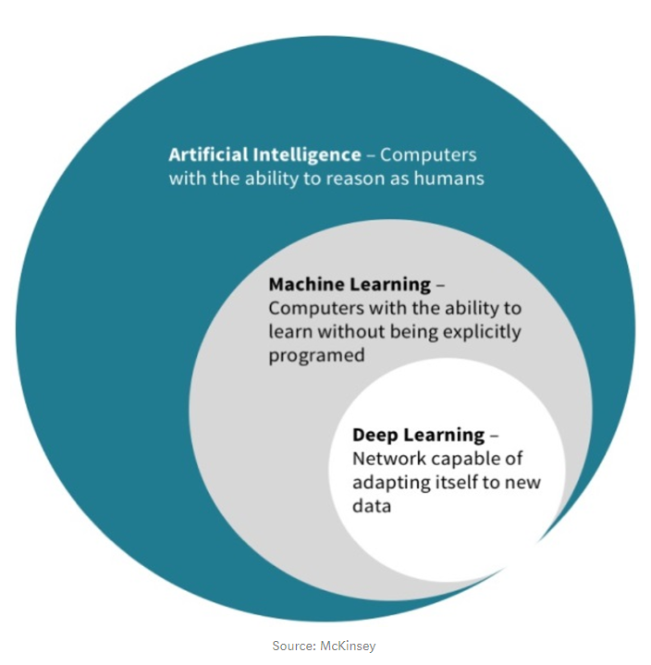
RECAP
Artificial Intelligence is a broader class which includes Machine Learning.
Deep Learning is part of the broader class of Machine Learning based on artificial neural networks.
Notes:
Machine learning is the science of getting computers learn from observations and real-world interactions and making predictions based on that learning. And to classify it from Artificial Intelligence, it is a subset of the broader class of AI where AI is the concept of performing tasks by machine that require human intelligence. Thus ML can be said as a step to reach AI.
Machine learning includes deep learning – a special ML technology based on artificial neural networks, it’s an advanced step to reach further closer to the level of absolute AI.

Slide 5
2. Types of ML Problems
Notes:
How do we categorize machine learning problems. To define what machine learning model is to be implemented, massively depends on what kind of problem we have in hand.

Slide 6


TYPES OF MACHINE LEARNING PROBLEMS
Machine learning problems can be classified based on how ML systems are trained:
Supervised
A supervised learning algorithm learns from labeled training data, it helps predict outcomes for unforeseen data.
i.e. Learning from the known (training) to predict the unknown (test) i.e. the learning is supervised.
Unsupervised
An unsupervised learning algorithm allows the model to work on its own to discover information. It mainly deals with the unlabeled data.
i.e. The goal of an unsupervised model is to identify meaningful patterns in the data.
Notes:
What kind of problem we have in hand, means how does this problem determine the “learning” of the machine, or how the machine is getting trained. Training of an ML system means how it is learning from the observations provided to it.
Supervised (or learning under supervision):
Given an input feature, you are telling the system what the expected output label is, thus you are supervising the training. The ML system will learn patterns on this labeled data. In the future, the ML system will use these patterns to make predictions on data that it did not see during training.
Thus, the machine learns from known or training data to predict the unknown or test data in supervised learning.
Just like a teacher or a mentor guides you through a particular topic in a way, where you are told what is the outcome of the learning and then you learn from it and try to do your best to match the outcome showed by your teacher during your exam.
Training data, it is the data provided by your teacher and test data is the data you get during your exam.
Unsupervised:
Where the machine or the learning algorithm learns on its own to discover information from the provided data, a data where the Machine is not told in prior what the expected output label is. It’s like self studying without any supervision from a teacher. You brainstorm the topics to understand it on your own.
Thus in unsupervised training, the model has no hints how to categorize each piece of data and must infer its own rules for doing so.

Slide 7
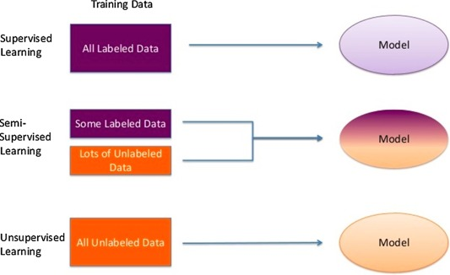
TYPES OF MACHINE LEARNING PROBLEMS
Notes:
It can be a combination of both types as well, where we have some labeled data (which is supervised) and unlabeled data (unsupervised) to solve a particular problem. In that case, it is called a semi-supervised learning or approach.

Slide 8

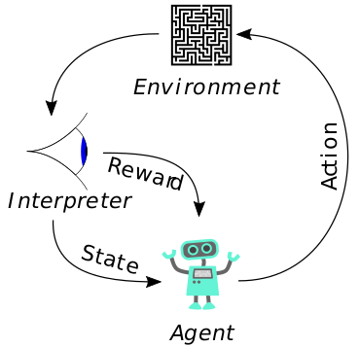
TYPES OF MACHINE LEARNING PROBLEMS
Reinforced
A reinforcement learning or reinforced learning algorithms allow the system to react to an environment in their own.
i.e. The focus is on finding a balance between exploration (of uncharted territory) and exploitation (of current knowledge)
Note: More about Reinforced learning can be found here.
Notes:
There is another type of ML problem called reinforcement/reinforced learning. This concept is newer compared to the previous types.
Here the algorithms learn to react to an environment on their own.
There are concepts like learning agent, start state, end state and environment.
So, for a learning agent, there is always a start state and an end state. However, to reach the end state, there might be a different paths that are taken by that agent. In Reinforcement Learning Problem an agent tries to take action in the environment by traveling from one state to another. The agent gets the reward(appreciation) on success but will not receive any reward or appreciation on failure. In this way, the agent learns from the environment.
Reinforcement learning is rapidly growing and moreover producing a variety of learning algorithms. These algorithms are useful specially in the field of Robotics, Gaming etc.

Slide 9
TYPES OF MACHINE LEARNING PROBLEMS
SOME MACHINE LEARNING CONCEPTS
Feature
A feature is an individual measurable property or characteristic of a phenomenon being observed. Can be loosely called as the input to a ML Model. Also known as ‘variable’ or ‘attribute’.
Label
Label is the true outcome of an ML Model or the ground truth. In Supervised learning; the input data is labeled, means the data samples are tagged to one or more labels whereas in Unsupervised, they are not unlabeled.
Notes:
Here, we have some common concepts that are mentioned every now and then while explaining a ML problem.
Features: if we consider a tabular dataset, the column names will be the features or variables of our data.
Label: it is the true outcome that we want our ML model to predict.
Let’s try to understand this with an example:
Imagine how a toddler might learn to recognize things in the world. The parent and the toddler read a picture book, with photos of animals. The parent teaches the toddler but pointing to the pictures and labeling them like: "this is a dog", "this is a cat", "this is a tree", "this is a house", …
After the toddler learns enough examples, the toddler gets a grasp on what are the key features of a dog, vs those of a cat or of a house or of a tree. So when the parent points to a thing they have never seen before, and asks the toddler "what's that?", the toddler is capable of generalizing their learning, and correctly answer "it's a dog". What might have happened behind the scenes is that consciously or subconsciously, the toddler extracted and examined the features of the "thing" - four legs, fluffy hair, sticking tongue, etc - which aligned nicely with their perception of a "dog", and did not match any of the other entity types they know.
So labels were the ground truth categories provided explicitly by their parent during learning. And features are what they inferred from these implicitly, and then extracted and examined at "run time“.

Slide 10
TYPES OF MACHINE LEARNING PROBLEMS
SOME MACHINE LEARNING CONCEPTS
Training Data
In supervised learning, the data is fed to an algorithm in a process called training. This data contains features with their corresponding label and is called training data.
Test data
An unlabeled data is fed to the trained model to predict its labels based on the supervision of the training data. This unlabeled/unknown data is the test data.
Notes:
Training dataset is the dataset which is labeled and is used to train the machine learning model with.
Whereas test dataset is the data where the trained model is tested on. An unlabeled data which decides how good our model has learnt or how good our model is in total.
So, the training dataset in the previous example are the photos in the picture book, the parent used to train the toddler and the test data is the one that was pointed to at the park.

Slide 11
TYPES OF MACHINE LEARNING PROBLEMS
SOME MACHINE LEARNING CONCEPTS
Model
Supervised: During training, the algorithm gradually determines the relationship between features and their corresponding labels. This relationship is called the model.
Unsupervised: The model is the relationship between features of the unlabeled data which drives for information discovery.
Reinforced: The model is the transition function between different state-action pairs by the agent in the environment.
Notes:
Model: A machine learning model can be a mathematical representation of a real-world process.
In case of supervised learning, To generate a machine learning model one will need to provide training data to a machine learning algorithm to learn from.
The algorithms implemented inside the machine learns from the training dataset and determines relationships between features and their corresponding labels, this relationship is what we call a model.
In case of unsupervised learning, where there is no concept of labels, the model is the relationship between features of the unlabeled data which drives for some information discovery.
Whereas in case of reinforced learning, The model is the transition function between different state-action pairs by the agent in the environment.
There can be model-based and model-free reinforcement learning, but this is out of scope of this training.

Slide 12
TYPES OF MACHINE LEARNING PROBLEMS
HOW DOES SUPERVISED LEARNING WORK?
Data available
Desired output
Weather (degrees) | Time (hh:mm) | Holidays (yes|no)
17 | 9:30 | yes
10 | 12:15 | no
3 | 17:10 | no
Commuting time (hh:mm)
00:20
01:30
02:40
Training data (labeled)
Predict based on unknown data
Weather (degrees) | Time (hh:mm) | Holidays (yes|no) | Commuting time (hh:mm)
35 | 6:30 | no | 00:45
25 | 15:35 | no | 00:50
8 | 22:14 | yes | 01:00
Weather (degrees) | Time (hh:mm) | Holidays (yes|no)
23 | 11:22 | no
Commuting time (hh:mm)
00:38
Notes:
Example of what supervised machine learning:
Let’s say, we want to predict how long it will take to drive home from the workplace.
The labelled data contains the following features:
Weather conditions
Time of the day
Holidays
These features are the inputs to the model and the output is the amount of time taken to drive back home on that specific day.
The training set will contain the above features and the total commute time for that day.
Based on the training data, the model may see relationships between the amount of rain and the time taken to go home.
The model may also see a connection between the time of leaving work and the time taken on the road.
Based on the training data, the model may see relationships between the amount of rain and the time taken to go home.
So, it ascertains that the more it rains, the longer you will be driving to get back to your home. It might also see the connection between the time you leave work and the time you'll be on the road. The closer you're to 6 p.m may be the longer time it takes for you to get home. In this way, the machine may find some of these relationships with the labeled data.
Thus, in supervised learning, The ML system will learn patterns on the labeled data. In the future, the it will use these patterns to make predictions on data that it did not see during training.

Slide 13
TYPES OF MACHINE LEARNING PROBLEMS
HOW DOES UNSUPERVISED LEARNING WORK?
Let’s say, a Telecom provider wants to do targeted marketing based on the purchase history, interests, activity monitoring etc. of their customers.
They can identify the type of customers by identifying patterns in terms of money spent in recharging, sending SMS, and browsing the internet.
This grouping would help the company target specific clusters of customers for specific campaigns.
In marketing, customer segmentation according their similarities is a common business approach.
Notes:
Example of unsupervised machine Learning:
Let’s say, we want to improve the customer-base based on purchase history, interests, activity monitoring etc. And we don’t have a desired outcome in this case, which means the input data is unlabeled. We want the model to analyze this unlabeled data to give us meaningful information.
So, based on the relationships between different data points of different features in the unlabeled data, the model can be told to adopt different statistical measure to form clusters of customers with similar buying habits.
Clustering, the most popular unsupervised machine learning approach is often used for Target marketing; telecom providers can cluster pre-paid customers to identify patterns in terms of customer spending money on recharging, sending SMS, their internet usage etc to target specific clusters of customers for specific campaigns.

Slide 14
TYPES OF MACHINE LEARNING PROBLEMS
TYPES OF SUPERVISED LEARNING
Classification
Classification means to classify an output to a label.
If the model tries label output into two classes, it is called binary classification (0 or 1 / yes or no).
Selecting between more than two classes is referred to as multiclass classification.
E.g. Predicting if there will be delay in reaching home from work (based on the previous supervised example)
Regression
Regression technique predicts a single output value using training data.
E.g. Predicting how much time taken to reach home from work.
Notes:
Further classifying supervised learning:
The most popular among them are classification and regression.
Classification is to classify/predict an output to a label, it can be two-class, called binary classification(whether 0/1 or Yes/No).
Or can be multi-class e.g. weather classified as Chilly, cold, breezy, warm, hot, rainy etc.
From the example of supervised learning in the previous slide, predicting whether there will be delay or not in reaching home from work is what a classification problem is.
Regression on the other hand is to predict a single output value.
From the same previous example, we can say predicting how much time taken to commute from work to home is what a regression problem is.

Slide 15

TYPES OF MACHINE LEARNING PROBLEMS
TYPES OF SUPERVISED LEARNING

Slide 16
TYPES OF MACHINE LEARNING PROBLEMS
TYPES OF UNSUPERVISED LEARNING
Clustering
Deals with finding a structure or pattern in a collection of uncategorized data.
Clustering algorithms will process the input data and find natural clusters (groups) if they exist in the data.
One can also modify how many clusters the model should identify.
E.g. Clustering pre-paid customers to identify patterns in terms of money spent in recharging, sending SMS, and browsing the internet.
Association
Association rules allows to establish associations amongst data objects inside large datasets.
It discovers exciting relationships between variables in a large dataset(s).
Understanding these buying patterns can help to increase sales in several ways
Notes:
Subtypes of unsupervised learning. The most popular of unsupervised approaches are clustering, association and anomaly detection.
Example of clustering in the unsupervised learning example slide, it groups data-points based on finding a structure or pattern in a collection on unlabeled data. We can provide information to the model regarding how many clusters do we want. Example is what we saw regarding target marketing by telecom companies.
Associative rules or association:
discovers relationships between different variables in the dataset to establish associations amongst the different data objects in it.
It helps find relationships between data items using point-of-sale (POS) systems. Applying this algorithms to supermarkets, retailers discover links between different items purchased, called association rules, and ultimately use that information to predict the likelihood of different products being purchased together or how frequently an itemset occurs in a transaction.

Slide 17
TYPES OF MACHINE LEARNING PROBLEMS
TYPES OF UNSUPERVISED LEARNING
Association
E.g. If X & Y are often bought together:
Both X and Y can be placed on the same shelf, so that buyers of one item would be prompted to buy the other.
Promotional discounts could be applied to just one out of the two items.
Advertisements on X could be targeted at buyers who purchase Y.
X and Y could be combined into a new product, such as having Y in flavors of X.
Anomaly detection
For discovering unusual data points in the data samples
E.g. Finding fraudulent transactions discovering faulty piece of hardware or identifying outlier caused by human error during data entry
Notes:
E.g. If items X & Y are often bought together:
Both X and Y can be placed on the same shelf, so that buyers of one item would be prompted to buy the other.
Promotional discounts could be applied to just one out of the two items.
Advertisements on X could be targeted at buyers who purchase Y.
X and Y could be combined into a new product, such as having Y in flavors of X.
A very interesting association was found out in supermarket during weekends between buying baby food and diapers together with beer.
A funny association but it was able to be found out because of association rule learning.
There is another important unsupervised learning type called Anomaly detection:
It is implemented to automatically discover unusual data points in your dataset. This is useful in pinpointing fraudulent transactions, discovering faulty pieces of hardware, or identifying an outlier caused by a human error during data entry.

Slide 18
These are the basic or the core types of machine learning problems. And depending on the type of problem in hand, the type and amount of data we have, one should choose the type of problem solving.

Slide 19
3. The Machine Learning Mindset
Notes:
We know what kind of approach or methodology to implement but how do we develop and adopt a machine learning mindset.

Slide 20
THE MACHINE LEARNING MINDSET
MACHINE LEARNING CANNOT BE EVERYWHERE
One of the most important parts of the journey is to properly identify a machine learning problem.
As ML works differently than traditional programming approaches, we need to change the way we think about the problems.
Focusing in statistics more than in logic steps.
A model is generated based on experimentation (rather than on a reasoning based on requirements)
Notes:
One of the most important parts of this ML journey is to properly identify a ML problem.
We have seen in 101 how ML algorithms work differently than traditional programming approaches.
Traditional approach is based on logic and mathematical understanding
Whereas ML approach is based on statistics analysis, probability distribution and pattern inference of the input data.
Now based on that we have to identify if our problem can be solved with traditional programming approach or we have to adopt ML technique.
i.e. ML is about Focusing on statistics more than on logic steps.
An ML model is generated based on experimentation (rather than on a reasoning based on requirements)

Slide 21
THE MACHINE LEARNING MINDSET
TIPS TO IDENTIFY GOOD PROBLEMS FOR ML
Detect a clear use case
Understand the problem
Begin small
Focus on problems that would be difficult to solve with traditional programming
Cause probably some different solutions will need to be tested before finding the right model
It is more efficient to start using few feature with a hypothesis (rather than to rely totally on the ML algorithm)
Notes:
Once you decide to adopt the ML approach, the first, most important thing is to detect a clear use case. A use case that states, it is not possible to be solved with traditional programming methods, now understand what the problem really is, depending on that, classify your problem to fit into what type of ML modeling approach. Sometimes it is not so obvious and often one needs to experiment/ hit and trial a bit to finally recognize the type of methodology to be selected.
And always begin small. Always try to create a hypothesis for a small set of data, investigate the data, how it looks like, how it is spread across the different dimensions and then start implementing with basic algorithms step by step.

Slide 22

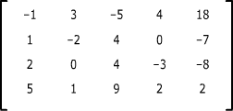
THE MACHINE LEARNING MINDSET
DATA NEEDS TO BE PROPERLY ADAPTED
For a ML model, knowledge and intelligence is encoded in a different way than for a person.
It is important to translate the data to a format the ML model can understand
What a person sees
What a ML model sees
Notes:
How a ML model looks at data or how we look at data are different. For us, here is an image of a car, for the model to understand that this is a car, it must be translated into an array of numbers that represents the car.
So, encoding of data is very important in a machine learning problem implementation.
Even the most popular and easiest of data format i.e. tabular data format with only numeric, binary or categorical data needs to be translated properly into ML language.
Most of the Machine learning algorithms can not handle categorical variables unless we convert them to numerical/binary values.
categorical values, as the name suggests means categories: these categories of data can be ordinal i.e. with an order e.g. good, average or bad or non-ordinal; without any specific order e.g. orange, apple, banana etc. So, it is up to us how we want the machine to perceive such kind of data.

Slide 23
4. Deep Learning
Notes:
Next comes, deep learning. A subclass of ML that works with artificial neural networks.

Slide 24
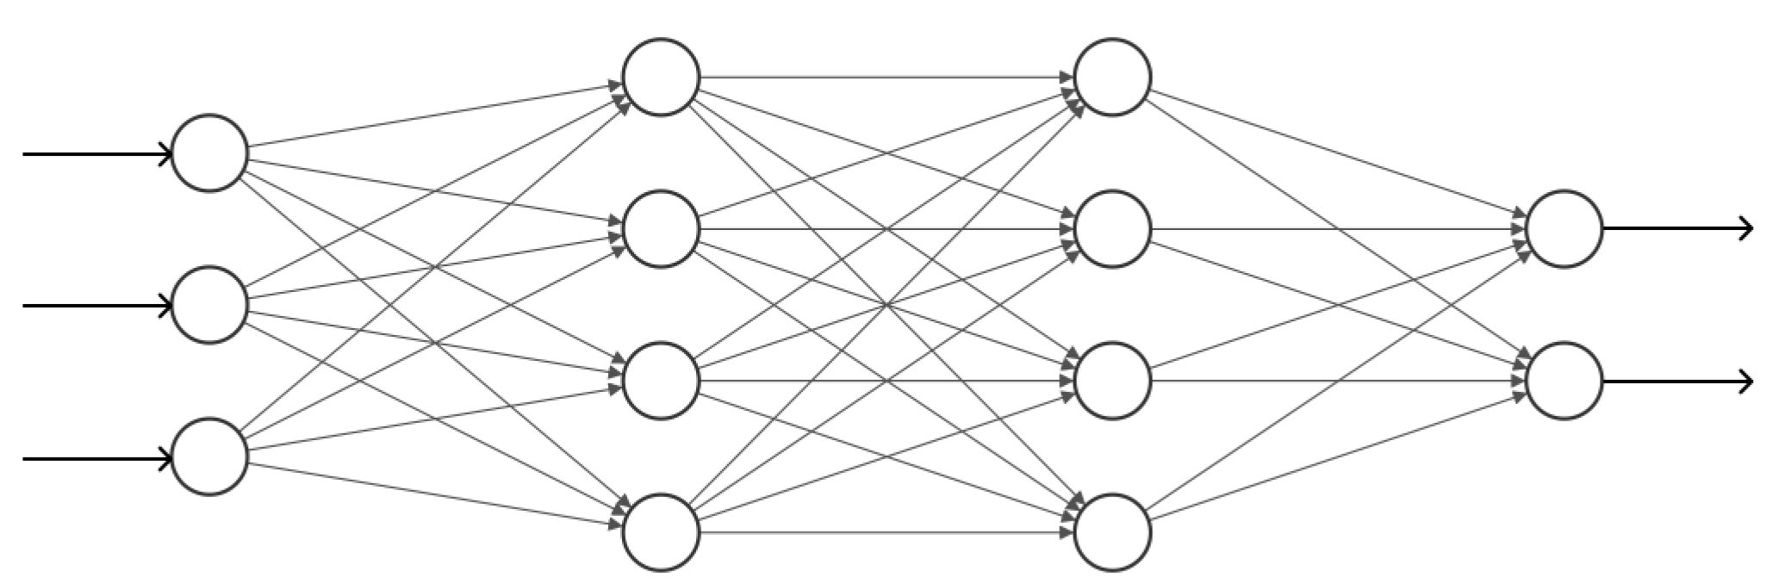
DEEP LEARNING
WHAT IS DEEP LEARNING ?
Deep learning is a subfield of machine learning.
In this case, the learning of the models is based on the processing of input data using successive linear layers, where the entrance of each layer is the output of the previous layer.
“deep” comes from the successive processing layers; so more the “depth” more the number of layers making up the model.
This successive-processing-layered structure is termed as Neural network/neural net.
Notes:
Deep learning is powered by neural networks. But nevertheless a machine learning technology. The definition of machine learning, the types of ML problems, the problem framing, everything aligns with this concept as well.
It is a powerful technology that enables AI to the most powerful extent and thus it is also called narrow-AI. And it is possible because of DL models having specific architecture and i.e. architecture that resembles that of a human brain.
In this diagram, the circles are the nodes or artificial neurons, which loosely models the neurons in the human brain. And the connections between the nodes are like the synapses in a biological brain, which can transmit a signal to other neurons. An artificial neuron that receives a signal then processes it and can signal neurons connected to it.
The learning of the models in deep learning is based on the input data processing using the successive linear layers of artificial neurons/nodes where the input of each layer is output of the previous layer.
The word “deep” comes from the successive processing layers, more depth means more layers in the model.
And this successive processing layered structure is termed as neural network.

Slide 25
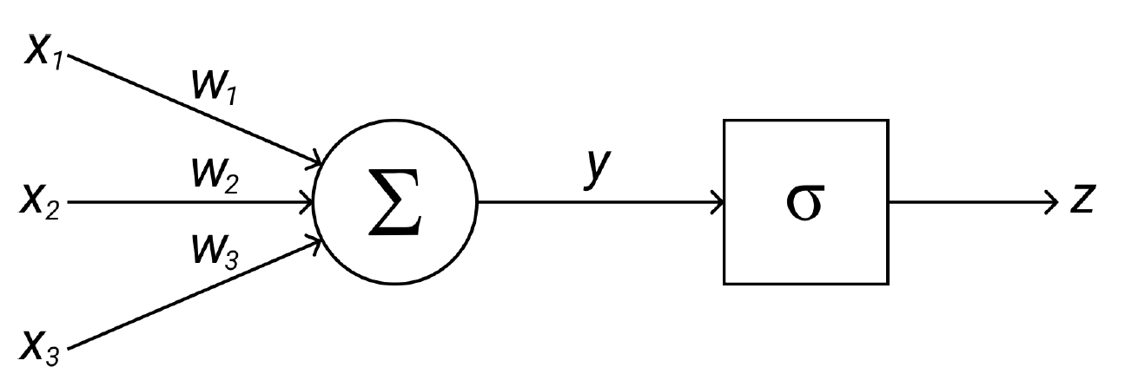
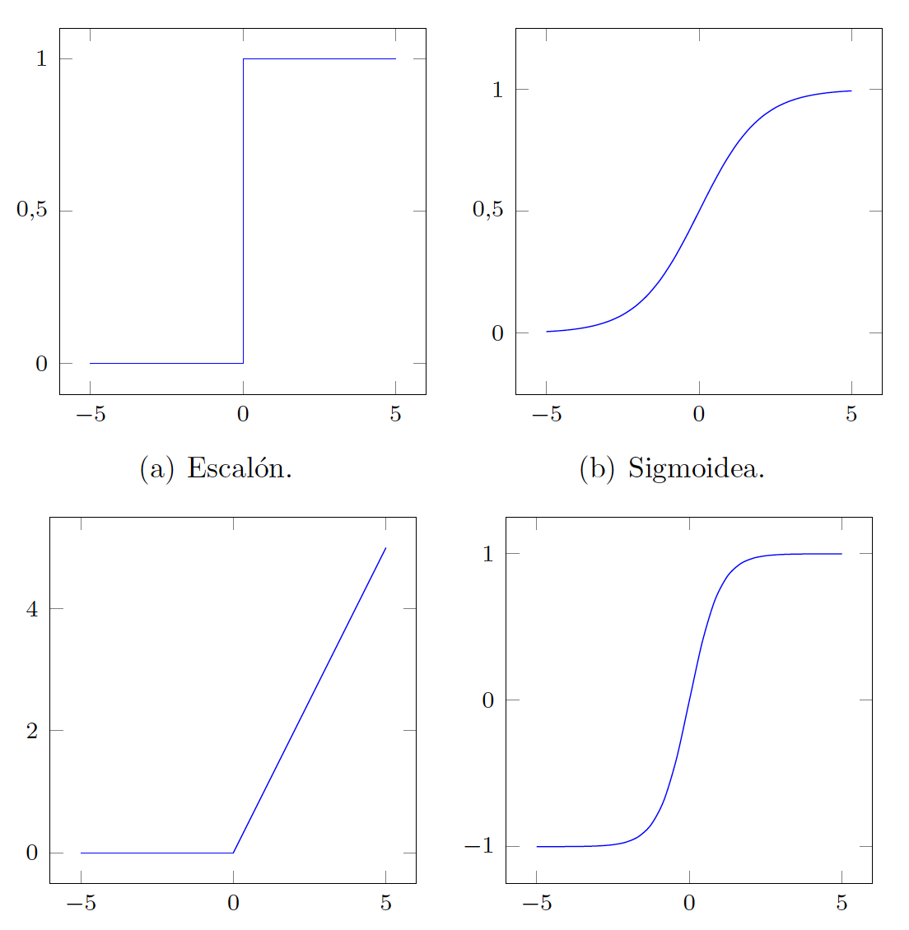
DEEP LEARNING
WHAT DOES NEURAL NETWORK DO?
The systems structured in successive linear layers that make up the Deep Learning models are called neural networks.
Its name arises from the fact that some of the concepts that determine its learning process is inspired by existing knowledge about the functioning of the brain.
However, neural networks cannot be considered as systems that model the learning of the brain.
It can be said that they are computational models that try to imitate its behavior remotely and crudely.
Notes:
Two very important point is to note regarding implementation of neural nets are:
They are computationally very expensive. Although computation power have reached to the point that nowadays it’s not a limitation anymore. But while framing an ML problem, it is very important to chose the right kind of approach based on what we have in our hand. There are specific problems where neural nets have proved to be the most successful and if you have similar problem in hand, gather resources needed prepare yourself in diving into deep learning.
And they require a large amount of data. At least hundreds of thousands to start with.
Deep learning has been able to achieve what we call narrow-AI, getting closer to the absolute idea of AI day by day. But just as it has been able to solve non-trivial problems at scale, the math behind it is not trivial at all and the fact that they’re computationally expensive, our motive behind implementing a deep learning approach shouldn’t be just because it is cool or because everyone uses it but when we are dealing with a use-case that absolutely requires the expertise of neural networks, and we have enough quality data in hand to be made use of, that’s when it is supremely effective and useful.

Slide 26
5. Natural Language Processing
Notes:
Now we go towards one of the most important areas, called natural language processing or NLP where both ML and DL have played and still plays very important roles in its development. And this area is crucial for Juniper because of the nature of most of Juniper data.

Slide 27
NATURAL LANGUAGE PROCESSING
NLP or Natural Language Processing is:
Focused on the enabling the computers to understand and interpret the human language.
Some part of it comes under narrow-AI and considered difficult problem in computer science.
Used to create systems:
Speech recognition
Document summarization
Language translation
Spam detection
Named entity recognition
Question answering
Autocomplete, predictive typing and so on.
Notes:
NLP or Natural Language Processing is focused on enabling the computers to understand and interpret the human language. And that includes text, voice/speech data.
A lot of NLP implementation falls under narrow AI and is considered a difficult problem in computer science.
The ultimate objective of NLP is to read, decipher, understand, and make sense of the human languages in a manner that is valuable to use.
Interpreting human language is not a set of rules or binary data that can be just fed into the system and understanding the context of a conversation or reading between the lines is altogether a different ball game.
This area of computer science has been used to create a lot of fascinating systems and here are some examples how NLP has facilitated the advancement of AI with time.
Speech recognition: Nowadays, smartphones have speech recognition. These smartphones use NLP to understand what is said, cortana, siri
Document summarization
language translation: Google translate; now google translate can even translate from a photo
Spam detection in our mailbox
named entity recognition like labeling words whether they are person names, locations or organization..
question-answering: e.g. a chatbot or a virtual assistant
autocomplete/autocorrect in our smartphone and so on.
So, all these breakthrough innovations that we have witnessed in this decade are because of advancement of NLP area.

Slide 28


NATURAL LANGUAGE PROCESSING
HOW DOES NLP WORK?
Applies algorithms to identify and extract the natural language rules such that the unstructured language data is converted into a form that computers can understand.
When the text has been provided, NLP technique will utilize algorithms to extract meaning associated with every sentence and collect the essential data from them.
Notes:
How does NLP work in a nutshell:
NLP is the technique where algorithms are applied to identify and extract the natural language rules so that the unstructured text data is converted into a form so that computers can understand.
It has the ability of text-mining and i.e. extracting meaning associated with every sentence and collect useful data out of it.
These can be done both syntactically, i.e. it makes grammatical sense and semantically; the meaning that is conveyed in the text.

Slide 29
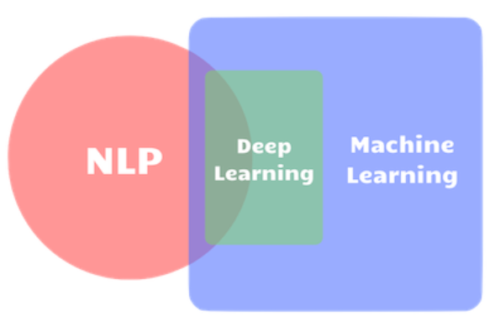
NATURAL LANGUAGE PROCESSING
NLP vs ML vs DL
Notes:
As we can see in this diagram, NLP itself is a huge area and its overlap with ML and DL signifies how ML and subsequently DL work as tools for many NLP tasks.
The previous examples of NLP facilitating the advancement of AI are the ones that can be said which fall at the intersection of the three areas.

Slide 30
NATURAL LANGUAGE PROCESSING
NLP vs ML vs DL
Locating & classifying named entities in text into pre-defined categories such as the names of persons, organizations, locations etc.
Analyzing text data to determine cluster of words for a set of documents that best represents the information in the collection.
Named Entity Recognition (NER)
Sentiment Analysis
Topic Modelling
Interpreting & classifying emotions (positive, negative and neutral) within text, whether a whole document, paragraph, sentence, or clause.
Notes:
To better understand the venn diagram, Here, there are some examples:
Example of a common and generic NLP application will be Named entity recognition (NER)
NER:
Named entity recognition (NER)is probably the first step towards information extraction, it seeks to locate and classify named entities in text into pre-defined categories such as the names of persons, organizations, locations, expressions of times, quantities, monetary values, etc. NER is used in many fields in NLP, and it can help answering many real-world questions, such as:
Which companies were mentioned in the news article?
Were specified products mentioned in complaints or reviews?
Does the tweet contain the name of a person? Does the tweet contain that person’s location? etc
Looking at the intersection of NLP with ML, one example is topic modeling, it’s a clustering method for text data; it can be described as a method for finding a group of words (i.e topic) from a collection of documents that best represents the information in the collection. It can also be thought of as a form of text mining – a way to obtain recurring patterns of words in textual material.
NLP has a strong linguistics component that requires an understanding of how we use language. The art of understanding language involves understanding humor, sarcasm, subconscious bias in text, etc. And that is the part of NLP that requires the expertise of neural network to work on this area, one example of the same is sentiment analysis.
Sentiment analysis allows businesses to identify customer sentiment towards products, brands or services. Understanding people’s emotions is essential for businesses since customers are able to express their thoughts and feelings more openly than ever before. Thus, By automatically analyzing customer feedback, from survey responses to social media conversations, brands can understand customer preferences and tailor products and services to meet their needs.
This was a sneak-peak on natural language processing and as text data or natural language data is in abundance in a big company, it is up to us how we can leverage this to develop actionable strategies and make informed decisions.

Slide 31
Summary
Types of ML methods are driven by the type of problem in-hand
The ML mindset is identifying a use-case, understand the problem behind it, look at the data available and finally choose the right ML method to solve it
More complex problems require more complex method
For each use-case, a combination of ML methods may apply
Notes:
The type of machine learning method to be chosen is driven by the problem in hand. One needs to adopt an ML mindset which includes identifying a use-case first, understand the problem behind it and the data available for the same and then choose the right machine learning method to solve it.
Complex problems require complex methods and depending on the use-case, combination of methods may apply.

Slide 32
Notes:
And here the ML 102 presentation concludes
In the upcoming sessions you will get a more comprehensive idea on ML problem-framing from the Google Developers guide.
Later, topics on Python installation and hands-on will be covered.
Also, we have included interactive python cookbook from Oreilly that supports an inbuilt Python environment for hands-on basic python commands, so if you don’t want to spend time on python installation, you can practice the basics of python from there.

